Slide 1
!
?
Youth
PROTECTION

Slide 2
KIDS
K
Kids
Who are we talking about?.
Involved
I
What is involved in the policy and what do I need to do to comply with the law, Insurance, RI & District
Doubts
D
What test to apply “If in Doubt”
Volunteer Screening
When, how and why?
S
Statement of Conduct
RI Working with youth
Notes:
I want to go through the following subjects
Statement of Conduct – what does RI state about working with youth
Doubts
If at any stage you are not sure with any situation that is projecting itself
Involved
What is involved in the policy and what do I need to do to comply with the law, Insurance, Ri and the District
Kids
Who are we talking about
Volunteer screening
When, How and why

Slide 3
RI Statement of Conduct for Working with Youth
“Rotary International strives to create and maintain a safe environment for all youth who participate in Rotary activities.
To the best of their ability, Rotarians, Rotarians’ spouses and partners, and other volunteers must safeguard the children and young people they come into contact with and protect them from physical, sexual, and emotional abuse”
Source: Rotary Code of Policies
Notes:
“Rotary International strives to create and maintain a safe environment for all youth who participate in Rotary activities.
To the best of their ability, Rotarians, Rotarians’ spouses and partners, and other volunteers must safeguard the children and young people they come into contact with and protect them from physical, sexual, and emotional abuse”

Slide 4
Our Obligations
When in doubt apply the test:
What would I expect if it were my child or grandchild?
Notes:
Our obligations when conducting any program involving young people, are no more than we would expect if it were our son or daughter participating in such a program.
When in doubt apply the test:
What would I expect if it were my child?

Slide 5
Rotary Youth Program Authorities
Each State and Territory in Australia.
The National Coordinating Committee for International Secondary Student Exchange (NCCISSE) oversees legislation.
Rotary International.
Rotary’s Liability insurer.
Notes:
To conduct a Rotary activity that involves young people, certain procedures might be required by the following authorities:
Each State and Territory in Australia has legislation for organisations who work with children.
The National Coordinating Committee for International Secondary Student Exchange (NCCISSE) oversees legislation.
Rotary International has mandatory & specific requirements.
Rotary’s Liability insurer has certain requirements.

Slide 6
Youth Protection compliance
Clubs that participate in any Youth Program shall:
Have a club Youth Protection Officer
Complete a signed compliance declaration
Maintain a Register of Volunteer Declarations
Provide copies of Volunteer Declarations to District for records retention purposes.
Complete and return their annual Insurance and Protection Declaration to the DIO prior to renewal.
Assign one club meeting per year for information & training
NSW Only – Shall be registered under Office of Children's Guardian and Verify WWC on line
Notes:
Clubs that participate in any Youth Program shall:
Youth Protection Officer
Complete Signed declaration
Ensure all Volunteers (as defined) are screened
Provide copies of all Volunteer Declarations to District
Ensure Clubs who participate in the YEP are “Certified”
Assign one meeting per year for information and training.

Slide 7
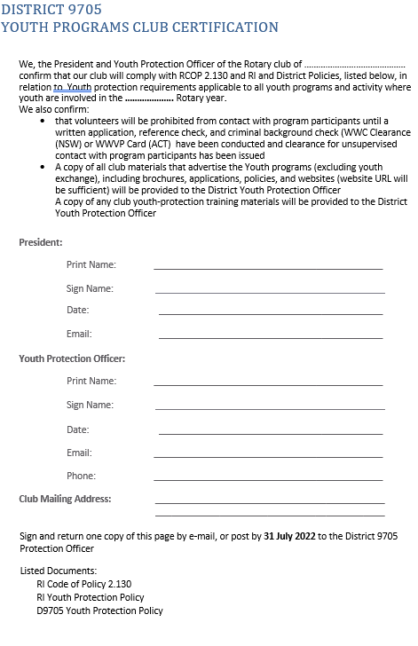
Youth Programs Club certification
Notes:
Clubs that participate in any Youth Program shall:
Youth Protection Officer
Complete Signed declaration
Ensure all Volunteers (as defined) are screened
Provide copies of all Volunteer Declarations to District
Ensure Clubs who participate in the YEP are “Certified”
Assign one meeting per year for information and training.

Slide 8
Who is deemed a “Volunteer”
Put simply, a Volunteer in these circumstances, is any adult person who might be in the position of being alone with a young person for a period of time.
Notes:
Definition:
A Volunteer is any adult involved with Rotary Youth Program activities that has direct interactions either supervised or unsupervised with youths/students.
Volunteers include among others:
Club and district Youth Exchange officers and committee members, Rotarian Counsellors, Rotarians and non- Rotarians, their spouses and partners who host youth/students for activities or outings, or who might drive youth/students to events or functions; and host parents and other adult residents of the host home, including siblings and other family members.
This person will have been police checked or formally reference checked in accordance with the state or Territory legislation.

Slide 9
Screening
“one on one” contact, or an adult person could be alone with a *young person for a period of time, that person shall be screened.
The screening process requires the adult person to provide a Volunteer Declaration.
* Definition of Young Person
Any individual who might participate in a Rotary Youth Program, regardless of whether or not they are of legal age of majority. Also referred to as children, child, youth, student or young people
Notes:
In the event that a Rotary organised project or activity allows for “one on one” contact, or an adult person could be alone with a *young person for a period of time, that person shall be screened.
The screening process requires the adult person to provide a Volunteer Declaration.
* Definition of Young Person
Any individual who might participate in a Rotary Youth Program, regardless of whether or not they are of legal age of majority. Also referred to as children, child, youth, student or young people

Slide 10
Is a WWC or WWVP check sufficient screening for a Volunteer?
Answer is No.
Whereas these checks might say that a person is eligible to work with young people, a Volunteer Declaration attempts to establish whether a person is suitable to work with young people.
Notes:
Answer is No.
Whereas these checks might say that a person is eligible to work with young people, a Volunteer Declaration attempts to establish whether a person is suitable to work with young people.

Slide 11
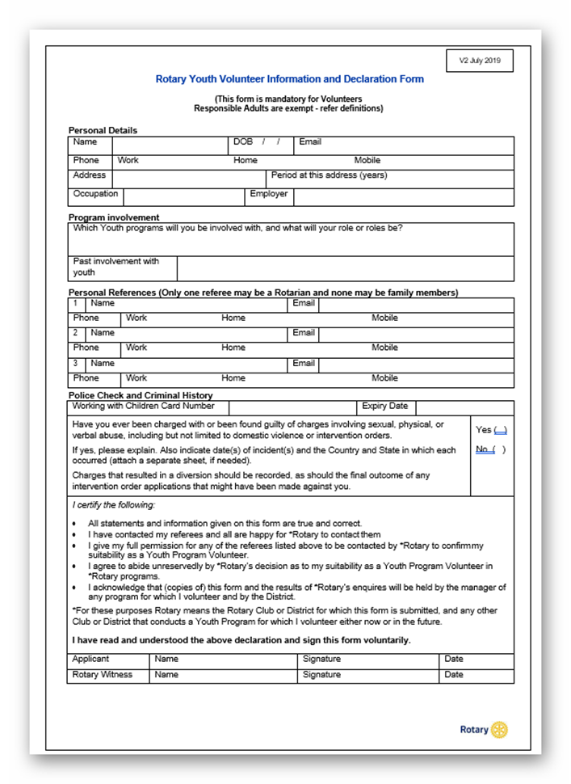
Volunteer Declaration
It is a statement made by Volunteers declaring themselves to be a fit and proper person, supported by referees to work with young people, and agree to Rotary International requirements & guidelines.
Names of three Referees
The relevant State/Territory Working With Children check
Criminal History check
Notes:
It is a statement made by Volunteers declaring themselves to be a fit and proper person, supported by referees to work with young people, and agree to Rotary International requirements & guidelines.

Slide 12
Volunteer Declaration
Notes:
You are signing this so make sure the declaration is completed correctly, referees contacted and the WWC or WWVP is current

Slide 13
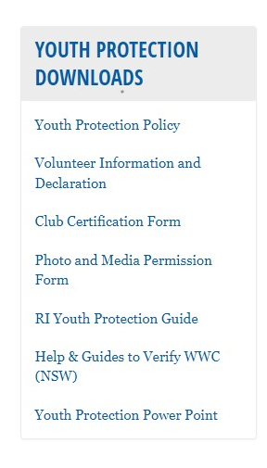
Forms and Policies

Slide 14
Are all Club Members deemed to be VOLUNTEERS?
The majority of Club members would be deemed
“Responsible Adults”
Notes:
Answer is No.
Most club members would interact with young people in a group situation, therefore not deemed to be Volunteers (as defined)
Those required to be screened by way of a Volunteer Declaration might be limited to:
President
Youth Protection Officer
Youth Services Director
Student Counsellor
YEP Host Parents/ family members
A Responsible Adult is any adult who, in a family or group situation for a short period of time, is responsible for caring for a youth/students.
This person will not have been police checked or formally reference checked.
The youth/student's Host Family and/or Club Counsellor needs to be satisfied, in the same way a conscientious parent would be satisfied, that this person is suitable for their own underage son or daughter to stay with for a short period of time

Slide 15
Who is exempt from screening?
Answer: No Volunteer is exempt.
Any adult person who falls under the category of a Volunteer (as defined) shall be screened.
Volunteer screening in respect of Youth Programs is:
a mandatory Rotary International requirement.
an Insurer requirement
A District Requirement
Notes:
Answer: No Volunteer is exempt.
Any adult person who falls under the category of a Volunteer
(as defined) shall be screened.
Volunteer screening in respect of Youth Programs is:
a mandatory Rotary International requirement.
an Insurer requirement

Slide 16
what to do in the event of an allegation
RI guidelines must be followed.
Found in the District Protection Policy.
* Details of such allegations must be reported to RI within 72 hours.
Notes:
Should a Rotarian or club receive a complaint or an allegation of abuse or harassment, the specific RI guidelines must be followed.
These RI Sexual Abuse and Harassment Allegation Reporting Guidelines can be found in the District Protection Policy.
* Details of such allegations must be reported to RI within 72 hours.

Slide 17
WHAT ABOUT THE DETRACTORS?
There is a simple answer……..
“We are asking nothing more than what you would expect if it were your son or daughter”
Be very proud of your efforts to protect young people entrusted to our care.
Notes:
How do you respond to the some who might say that all this stuff is over the top and unnecessary?
There is a simple answer……..
“We are asking nothing more than what you would expect if it were your son or daughter”
Be very proud of your efforts to protect young people entrusted to our care.

Slide 18
Questions

